Slide 1


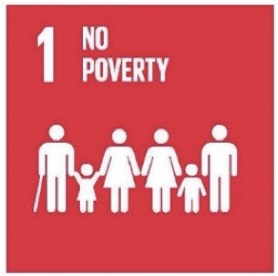

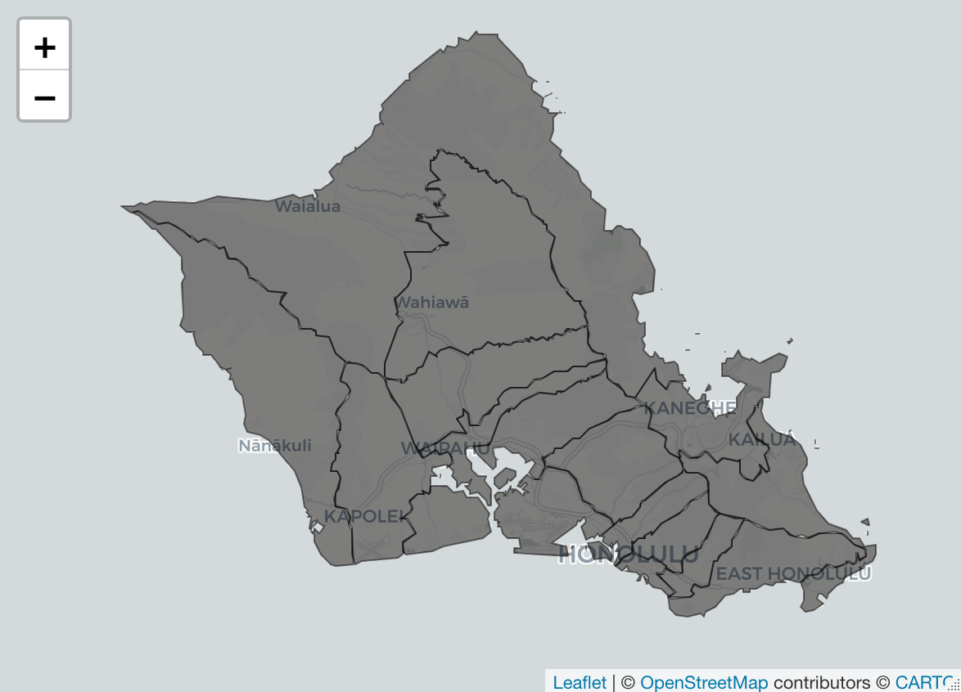
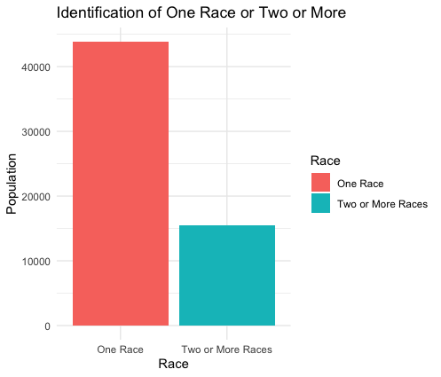
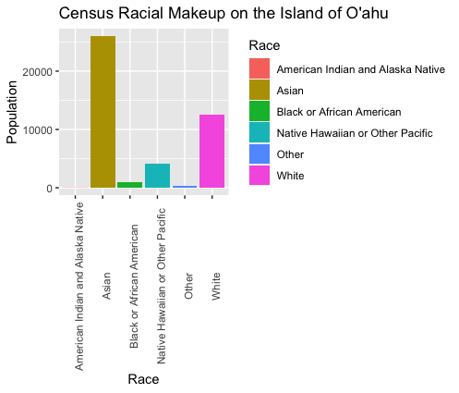
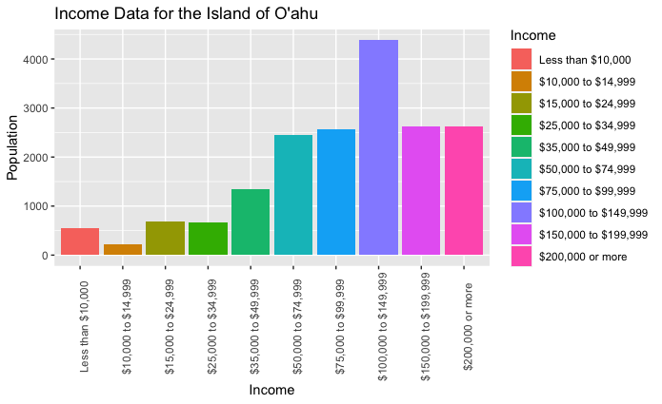




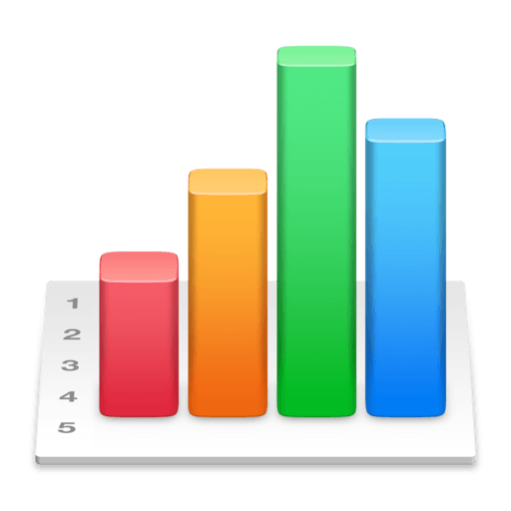
Racial Wealth Gap on the Island of O’ahu
Upumoni Logologo, Chaminade University of Honolulu, upumonipeleleagaga.logologo@student.chaminade.edu
Results
Introduction
The racial wealth gap is a pressing issue that has persisted for generations, reflecting deep-seated disparities in economic well-being among different racial and ethnic groups. On the island of Oahu, the most populous island in the state of Hawaii, this gap is an important lens through which to understand the economic inequities faced by its diverse population.
Discussion
-Figure 2: One race had the highest population.
-Figure 3: Asian and white had the highest population.
-Figure 4: The 100,000 - 150,000 annual income per household group was the highest.
Figure 1: Map of Oahu separated by district lines
Limitations
-Limited data available
-Data collection issue with Census
-Disaggregated data in Figure 4
Research Question
What is the racial wealth gap on the island of O’ahu?
Future Research
-Investigate the breakdown of races in the income data in Figure 4
-Explore outside resources like ALICE Threshold to evaluate racial wealth gap on Hawaii counties
Methods and Programs
-Qualitative research
-Content Analysis
-Reports from Hawaii Appleseed
-Data collection
-Census, Bureau of labor and statistics, American Community Survey,
-Resources
Figure 2: Comparison of one race and two or more races
Figure 3: Breakdown of races and ethnicities in Oahu
References
America Counts Staff. (2021, August 25). HAWAII: 2020 Census. Census Bureau. Retrieved June 28, 2023, from https://www.census.gov/library/stories/state-by-state/hawaii-population-change-between-census-decade.html
Legislative District Tool | UnitedForALICE. (n.d.). United For ALICE. Retrieved June 28, 2023, from https://www.unitedforalice.org/legislative-district-tool
Nahaas, R. (n.d.). 6.1 Categorical: Bar chart | An Introduction to R for Research. Bookdown. Retrieved June 28, 2023, from https://bookdown.org/rwnahhas/IntroToR/categorical-bar-chart.html#ggplot
Figure 4: Annual income by household

